Slide 1
DRUG REVIEW PREDICTION
T. MANISH
P.SAMPATH KUMAR
P.SAI MANIKANTA
P.JHANSI KUMAR
K.JOSHI MANOHAR(TL)

Slide 2
INTRODUCTION
The aim of the project is to create a opinion on the drug by doing sentimental analysis based on the reviews given by the previous users of the medicines.
Sentiment analysis refers to the use of natural language processing, text analysis, computational linguistics, and biometrics to systematically identify, extract, quantify, and study affective states and subjective information.
Natural language processing (NLP) is a subfield of computer science, information engineering, and artificial intelligence concerned with the interactions between computers and human (natural) languages, in particular how to program computers to process and analyze large amounts of natural language data.
Challenges in natural language processing frequently involve speech recognition, natural language understanding, and natural language generation.

Slide 3
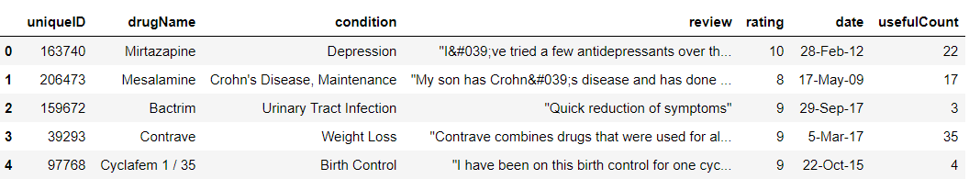
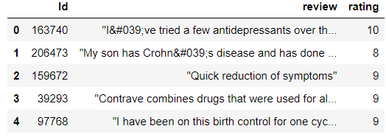
PRE PROCESSING OF DATA
Data preprocessing is a data mining technique that involves transforming raw data into an understandable format. Real-world data is often incomplete, inconsistent, and/or lacking in certain behaviors or trends, and is likely to contain many errors.

Slide 4
NLTK AND VADERSENTIMENT
NLTK stands for Natural Language Toolkit. This toolkit is one of the most powerful NLP libraries which contains packages to make machines understand human language and reply to it with an appropriate response. Tokenization, Stemming, Lemmatization, Punctuation, Character count, word count are some of these packages
VADER (Valence Aware Dictionary and sEntiment Reasoner) is a lexicon and rule-based sentiment analysis tool that is specifically attuned to sentiments expressed in social media. VADER uses a combination of A sentiment lexicon is a list of lexical features (e.g., words) which are generally labelled according to their semantic orientation as either positive or negative.

Slide 5
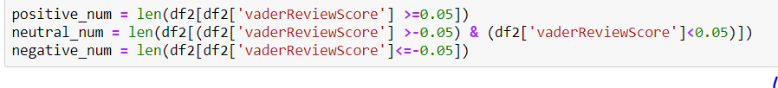

DESCRIPTION ON REVIEW CLASSIFICATION

Slide 6
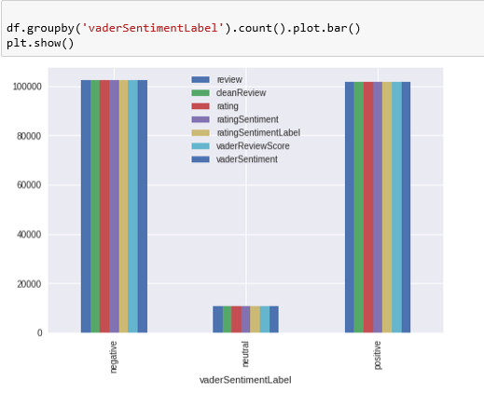
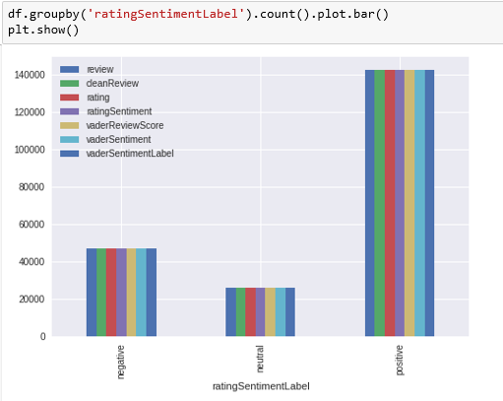
Graphical analysis

Slide 7
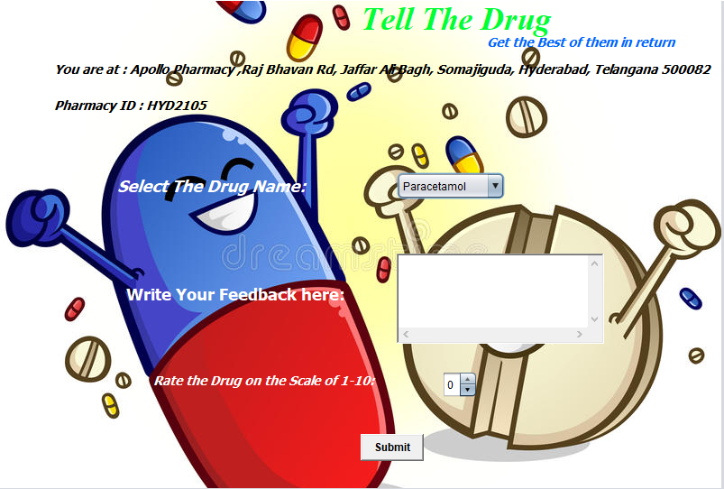
USER INTERFACE MODEL

Slide 8
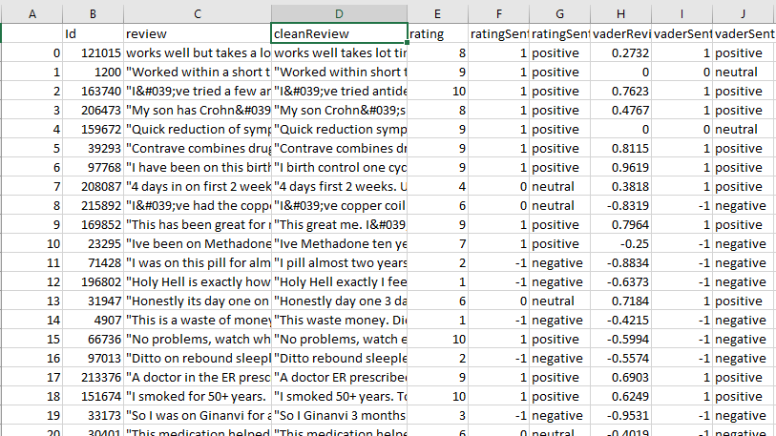
OUTPUT

Slide 9
Future Scope
There are lot ups and downs in effectiveness of specific drug in the market at a particular point of time,
and this follows a situation where doctors fell in dilemma for suggesting the best medicine for their patients.
This also effects the sales of those specific drugs which dont show much effectiveness which in turn leads to
loss for those Pharmaceutical Companies.
Who Produces the medicine : Pharma company
Who Suggests the medicine : Doctor
Who consumes the medicine : Patient
Which should be Effective in Maintaining a Healthy chain Among these 3 : Medicine/Drug.

Slide 10
So, we can reduce this imbalance by analysing the drug trends time to time and give an analysis report and overall
feedback about the performance of the drug in a particular week to Both Doctor and Pharma companies.
main point is which is the main source data for this analysis on Drug.
undoubtedly its Patients.
Tell The Drug is a trend analyser , which runs on Sentimental analysis segment of Artificial intelligence
How it works ?
There will be Tell the drug feedback machienes present at pharmacies across a particular city and each pharmacy
in the city is assigned with a particular ID. if a consumer purchases a particular drug at a pharmacy, then he will be able to give
feedback about a particular medicine which he purchases.

